Slide 1
Anomaly Detection in Crowds Group 2

Slide 2

Agenda
Introduction
Understanding the dataset
Data collection
Data preprocessing
EDA and Data Labels
Preliminary stastical Analysis
Machine learning Models
Model validation and evaluation
Real time anomaly detection
Results
Conclusion

Slide 3
Problem Statement
Utilizing advanced statistical and machine learning techniques, the goal is to develop an enhanced model capable of distinguishing between normal and anomalous behavior patterns in smartphone usage. This model aims to serve multiple purposes such as detecting suspicious activities, identifying potential hazards, and gaining deeper insights into crowd dynamics.

Slide 4
Introduction
The project aims to evaluate various techniques for building and testing anomaly detection models, with the ultimate goal of enhancing public safety by identifying potential hazards in crowds. By leveraging smartphone data,
the project seeks to gain deeper insights into crowd behavior through thorough data analysis. This multifaceted approach involves integrating multiple models and techniques to create a robust system capable of detecting anomalies in real-time,thereby contributing to improved crowd management and safety measures.
The objectives are multi-dimensional: understanding the dataset, evaluating different models, and implementing the best performing model to detect anomalies in crowds, ultimately providing actionable insights for public safety interventions..

Slide 5
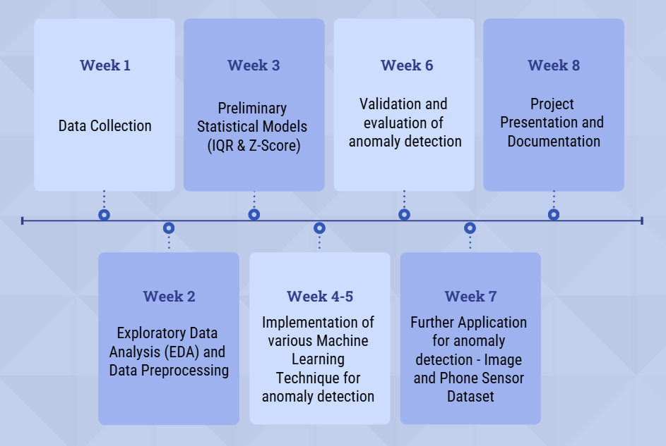
Weekwise Implementation

Slide 6
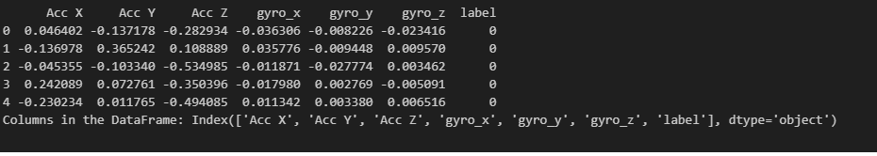
Exploratory Data Analysis (EDA)
1. Descriptive Statistics:
Purpose: To summarize and understand the main characteristics of the data.
Techniques:
Mean, Median, Mode: Central tendencies of the features.
Standard Deviation, Variance: Measures of dispersion.
Skewness and Kurtosis: Understanding the shape of the data distribution.
2. Visualizations:
Box Plots: To visualize the distribution of sensor readings and identify potential outliers.
Histograms: To analyze the frequency distribution of each feature.
Pair Plots: To study relationships between different features

Slide 7
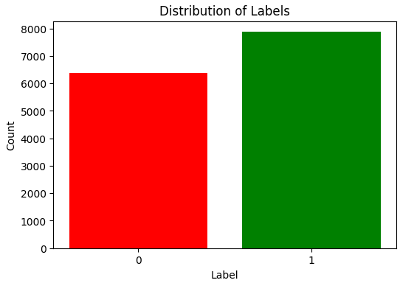
Data Labels
Data labels play a crucial role in the process of anomaly detection. In this project, data labels were obtained from smartphones in crowds, capturing various metrics such as location, movement patterns, accelerometer readings, and other sensor data. Orbit type SO has a 0% success rate.
These labels help in distinguishing between normal and anomalous behavior, forming the basis for model training and evaluation.

Slide 8
Data Preprocessing
Handling Missing Values: Missing values were imputed using mean or median, showing no significant impact on the overall dataset.
Outliers Treatment: Outliers were detected using box plots and were retained as they might represent genuine anomalies.
Feature Engineering: Additional network-related features were derived to enrich the dataset.

Slide 9
Initial Statistical Analysis
1.Descriptive Statistics:
Purpose: To summarize the main characteristics of the dataset
2. Data Distribution:
Histograms: Show the frequency distribution of each feature, providing insights into the data's spread and central tendency.
Box Plots: Highlight the median, quartiles, and potential outliers in the data, aiding in the detection of anomalies.
.
3. Data Quality Checks:
Missing Values: Identify and handle missing data using imputation methods like mean, median, or mode.
Outlier Detection: Use box plots and statistical tests to detect outliers, which may represent anomalies or errors in data collection.
Correlation Matrix: Examine correlations between features to identify multicollinearity and understand feature relationships.
4. Feature Engineering:
Time-Series Features: Extract time-based features such as moving averages, differences, and lag values.
.

Slide 10
Model Building and evaluation
Model Building and Evaluation
1. Candidate Anomaly Detection Algorithms:
Isolation Forest:
Objective: Detect anomalous smartphone usage patterns.
Implementation: Hyperparameter tuning and evaluation using precision, recall, F1-score, and confusion matrix.
Local Outlier Factor (LOF):
Objective: Identify anomalies by calculating local density deviation.
Implementation: Performance evaluation using standard metrics.
2. Model Descriptions and Evaluation:
Detailed description of each model's purpose.
Visualization of classification performance.
Precision, recall, F1-score, and accuracy.
3. Comparison and Best Working Model:
Using validation metrics and confusion matrices.
Identifying the model with the highest precision and recall.

Slide 11
Applications of Models phone sensor dataset
1. Anomaly Detection in Smartphone Usage:
Objective: Identify unusual patterns in sensor data that may indicate abnormal behavior or events.
2. Activity Recognition:
Objective: Classify different user activities (e.g., walking, running, sitting) based on sensor data.
3. Health Monitoring:
Objective: Monitor health-related metrics such as physical activity levels and detect potential health issues.
. User Authentication:
Objective: Use sensor data to verify the identity of a smartphone user based on their unique behavioral patterns.

Slide 12
Confusion Matrix
The confusion matrix is a crucial tool for evaluating the performance of
anomaly detection models. It provides a detailed breakdown of the model's
predictions, allowing us to calculate key validation metrics. The confusion
matrix consists of four components:
True Positives (TP): Correctly identified anomalies.
True Negatives (TN): Correctly identified normal points.
False Positives (FP): Normal points incorrectly identified as anomalies.
False Negatives (FN): Anomalies incorrectly identified as normal points.

Slide 13
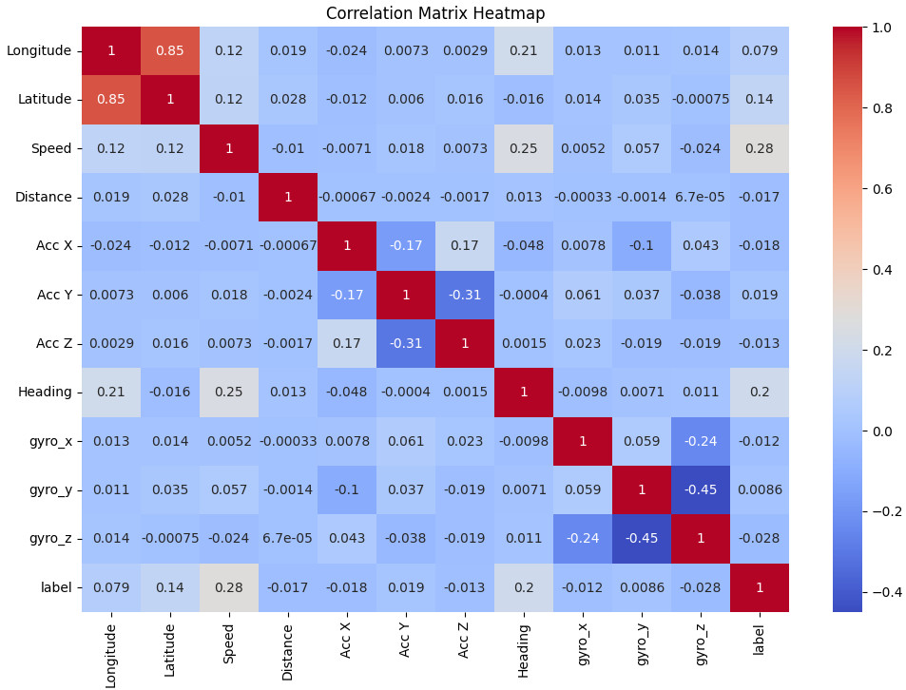

Slide 14
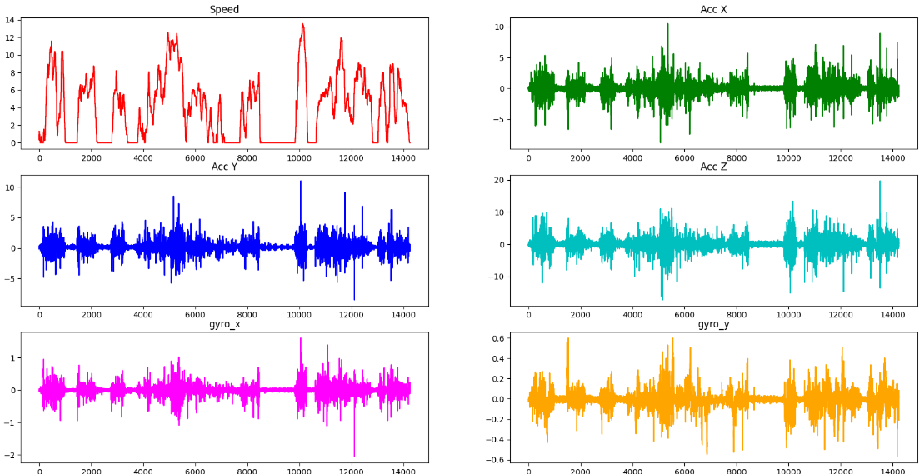

Slide 15
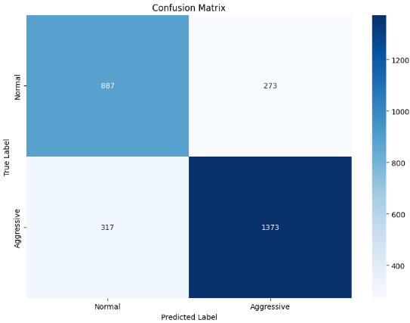
Isolation forest Model
The Isolation Forest model is an ensemble learning method specifically designed for anomaly detection. It isolates observations by randomly selecting a feature and then randomly selecting a split value between the maximum and minimum values of the selected feature. Key steps in the Isolation Forest model include:
Training: Constructing an ensemble of isolation trees, where each tree isolates observations by random splits. Anomalies are isolated with fewer splits, resulting in shorter paths in the tree.
Scoring: Assigning anomaly scores to data points based on their average path length across all trees in the ensemble. Data points with shorter average path lengths are considered anomalies.
Thresholding: Setting a threshold on the anomaly scores to distinguish between normal and anomalous data points.

Slide 16
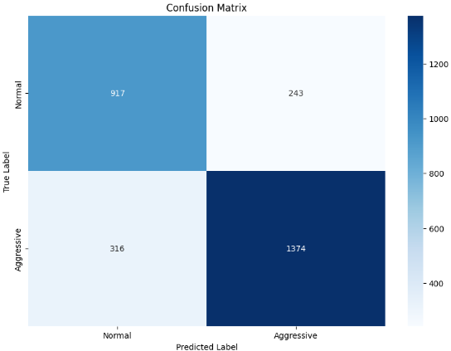
DBSCAN Model
Density-Based Spatial Clustering of Applications with Noise (DBSCAN) is a popular clustering algorithm used for anomaly detection. It identifies clusters of data points based on density and marks points in low-density regions as anomalies. Key steps in the DBSCAN model include:
Parameter Selection: Choosing the epsilon (ε) parameter, which defines the radius of a neighborhood around a data point, and the minimum number of points required to form a dense region.
Clustering: Grouping data points into clusters based on density. Points in high-density regions are grouped together, while points in low-density regions are marked as anomalies.
Anomaly Detection: Identifying data points that do not belong to any cluster as anomalies.

Slide 17
Future scope
Further Scope
Enhanced Data Collection:
To gather more diverse and comprehensive data to improve model robustness.
Collaborations with more repositories and real-time data collection.
To derive more sophisticated features for better anomaly detection.
Time-series analysis, frequency domain features, and contextual information.
Integration of Deep Learning Models:
To explore more complex patterns and relationships in the data.
Recurrent Neural Networks (RNNs), Long Short-Term Memory (LSTM) networks, and Convolutional Neural Networks (CNNs).
Real-time Anomaly Detection:
To implement models that can detect anomalies in real-time.
Deployment and Monitoring:
: To deploy the best-performing model in a real-world scenario.
: Continuous evaluation and updating of the model to maintain performance.

Slide 18
Result and Best Model
1. Real-time anomaly detection system:
Implementation of a system to detect anomalies in real-time using smartphone data.
2. Contribution to public safety:
Enhanced ability to identify potential hazards and ensure crowd safety.
3. Enhanced understanding of crowd behavior:
Insights into normal and anomalous crowd behavior patterns.

Slide 19
Conclusion
Summary of achievements:
Successful development of a multidimensional anomaly detection system
Evaluation of multiple models and identification of the best performer.
Future work and improvements:
Integration with other data sources for improved accuracy
Continuous learning to adapt to changing crowd behaviors
Deployment in real-world scenarios to enhance public safety

Slide 20
Group Work
Kunjan Singh : Worked on EDA part, flask and UI, and video task
Pallavi Kaushik : Worked on EDA part, model building and Final report
Shaik Samiulla : Worked on EDA part, ppl,and Final report

